Slide 1
Theme 4 - Withdrawal of Candidature
Guidance Plan:
The time for withdrawal of candidature starts immediately after scrutiny of nomination and ends at 3:00 PM on the last date specified in the Notification, i.e. second day after the scrutiny. The RO should be clear w.r.t framework of withdrawal as any error would be a material defect likely to vitiate the electoral process. Accordingly, RO must be familiar with the statutory formats, the timelines and the key persona, other than the candidate who can be authorised to make a claim of withdrawal.
Withdrawal notice to be in statutory format (Form 5) signed by the candidate.
RO to note that this notice can only be submitted by the candidate himself or by the election agent/a proposer after list of validly nominated candidates is prepared.
Also note that if election agent or proposer is delivering the withdrawal notice to the RO, there has to be a written authorization from the candidate, designating agent/proposer to deliver the notice. Hence, RO has to carefully verify the identity of the person delivering the withdrawal notice. There is past instance of RO accepting withdrawal notice delivered by unauthorized person which later led to the election being set aside by High Court in election petition.
Withdrawal notice, validly submitted, cannot be cancelled/rescinded.
Lastly the RO is expected to clearly understand the vital step of preparation of the list of contesting candidates (Form 7A). The RO may note that prior to the finalizing of the said list, allotment of symbols has to be undertaken which is explained in the next thematic PPT.

Slide 2
Notice of Withdrawal of Candidature – S 37, RPA 1951
Any validly nominated candidate can give notice of withdrawal in Form 5 (COER 1961) till 3 p.m. on last date fixed for withdrawal.
1) once the scrutiny is over
&
2) validly nominated candidate list is published
NB1: Last date of withdrawal will be the 2nd day after the day of Scrutiny unless that day happens to be a public holiday.
NB2: On the date of scrutiny and the next day, withdrawal notice can be submitted anytime during usual office hours
NB3: The activities at the time of submission of withdrawal notice should be videographed

Slide 3
To receive notice and publish withdrawal of candidatures
Form 5: Notice of withdrawal
To be delivered to RO/ARO by …..
A validly nominated candidate by himself
A proposer of that candidate
Election agent of that candidate
NB 1: Proposer or Election agent to be authorized in writing to deliver the notice of withdrawal
NB 2: Has to be delivered in person only by authorized persons
Contd…

Slide 4
To receive notice and publish withdrawal of candidatures – contd.
Form 5 contains receipt in bottom portion which is to be filled in by RO and handed over to person who delivers notice.
NB 1: Valid withdrawals cannot be cancelled as per S 37(2), RPA 1951
NB 2: Publish notice of withdrawal on notice board in Form 6.

Slide 5
Sample Question on withdrawal of candidature
Mr. X is a validly nominated candidate. Mr.Y is a prominent personality in the area and known to have worked for Mr. X for the past 20 years. He is not his election agent nor proposer. Today is the last date for withdrawal of candidature but Mr. X has gone far in the State for some very important family reason. He makes a telephone call to you (RO) that he intends to withdraw his candidature and is sending Mr.Y to deliver notice of withdrawal of his candidature in Form 5 duly singed by him (Mr. X) in original.
What will you Do as an R.O. ?
Answer: As per S 37 RPA, 1951, the withdrawal notice can be submitted by the candidate himself or by election agent/any of the proposers who are specifically authorised in writing by the candidate. Thus, Mr.Y is not competent to submit the withdrawal notice.

Slide 6
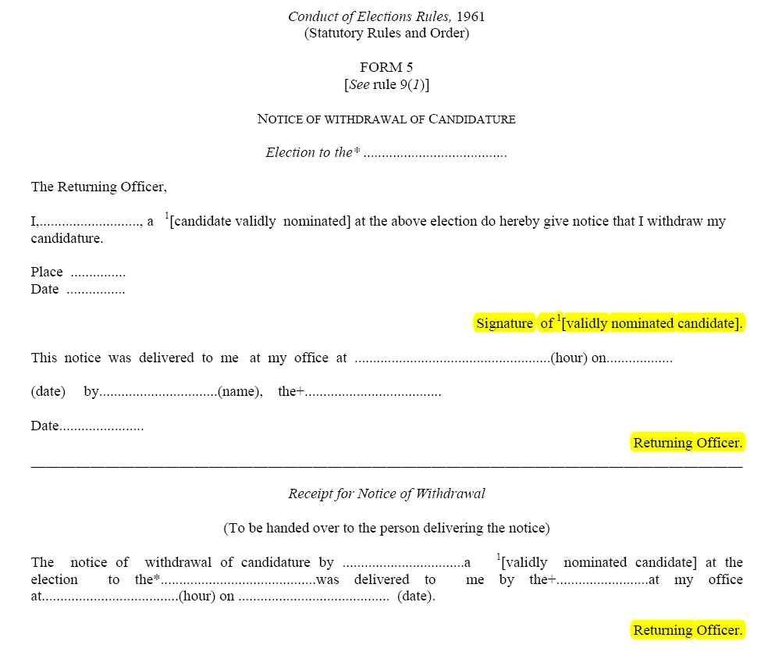
Form 5
Contd…

Slide 7
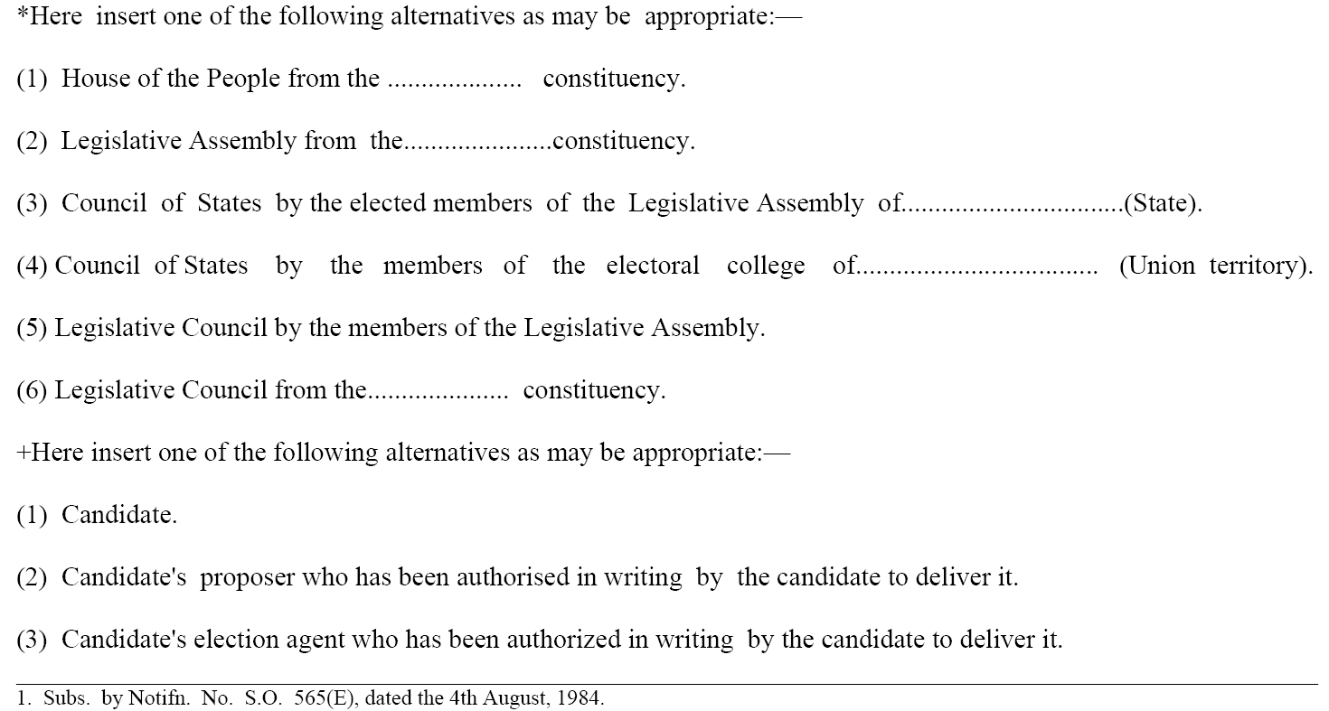
Form 5

Slide 8
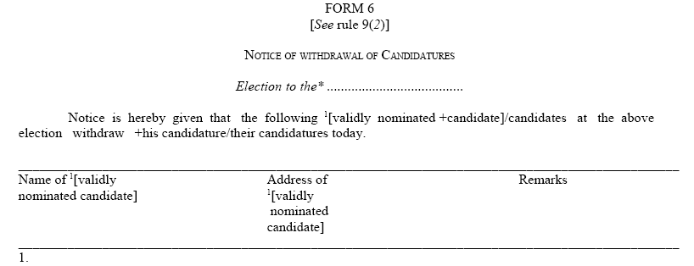
Form 6 (COER 1961): Form for publishing withdrawal by RO

Slide 9
To prepare list of Contesting Candidates
Immediately after 3 PM (and after allotment of Symbol) on last day for withdrawal draw up Form 7A (COER, 1961) (list of contesting candidates), whose nomination papers were valid and who have not withdrawn their candidatures.
Names of the candidates to be provided in same manner as in the List of validly nominated candidates, alphabetically under 3 categories (Recognized National/State Political Party; Registered Unrecognized Political Party (RUPP); Independent Candidates)
NB: No hierarchy between National and State Party for this purpose
Photo of the candidate will also be there in addition to Party affiliation & symbol.
Contd…

Slide 10
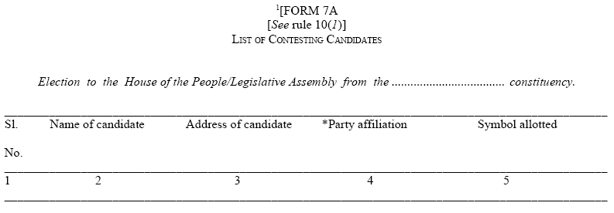
To prepare list of Contesting Candidates - contd
Form 7A: List of Contesting Candidates

Slide 11
To publish and supply/distribute the list of Contesting Candidates (S 38, RPA 1951; R 10 & 11 COER 1961)
Publish list at conspicuous/prominent place in RO’s Office
Supply copy of list to contesting candidates/election agent
This list will be published outside each polling station (on day of poll)
Send copy to CEO immediately along with symbols allotted to them (by fastest means of communication)
Delay will affect printing of ballot papers
Send copy of list with English translation to ECI
Contd…

Slide 12
To publish and supply/distribute the list of Contesting Candidates – contd.
Publish list of Contesting Candidates in Official Gazette as per R 11(2) COER, 1961
Arrange for such publishing through CEO
NB 1: Publish notification as notification by ECI (notification format as annexed in RO Handbook)
NB 2: Prepare the list even if a case of uncontested election but not necessary to publish in Official Gazette (R 11 COER, 1961)
NB 3: As per R 8 , COER, 1961, candidate may request RO to modify his/her name if it is incorrectly shown or is different from the name by which he/she is popularly known. Such request has to be made before preparation of list in Form 7A. If RO is satisfied that the request is genuine, he shall allow the correction

Slide 13
Importance of Form 7A for subsequent electoral steps - listing
Generating ETPBS based on Form 7A for Service Voters
Printing of Ballot Paper and Postal Ballot paper for other categories, is based on candidate details contained in Form 7A
Form 7A becomes the reference document for preparing the declaration of results and certificate of election
It informs all IT Platforms and Apps of the ECI, when reflecting the details of that particular candidate
The address of candidate mentioned in form 7A is used for future communications, e.g., notice regarding election expenditure account etc.
NB: RO should take utmost care to ensure that all details appearing in form 7A are correct and complete. Errors/mismatch in names/order of names / symbols/ photograph of candidates will have serious consequences

Slide 14
Sample questions on withdrawal of candidature
Milan Raj, President of different NGOs & Leader of his community is a candidate of a registered political party in Faridpur assembly constituency.
Neeta Pahva, an advocate by profession, is a candidate of a recognized political party (state) in the same constituency.
They are distant relatives but some long pending social issues are there between the respective families.
The Election program is like this:
Last date of nomination | 10 November
Scrutiny | 11 November 11.00 AM at R.O.’s office
Last date of withdrawal | 13th November not later than 3.00 PM
Contd…

Slide 15
Sample questions on withdrawal of candidature – contd.
On the date fixed for the scrutiny, RO starts scrutiny of the nomination papers one by one. Process was going smoothly as there were nominations of only recognized parties and non-recognized parties. There was no independent candidate.
As RO starts scrutinizing the nomination of Neeta Pahva, Milan Raj challenged the candidature by raising objection.
Neeta Pahva also raises her objection against the nomination of Milan Raj
Both the candidates apply for the adjournment to rebut the objection raised against them.
RO adjourns the hearing on the following day, which was a working day.
Contd…

Slide 16
Sample questions on withdrawal of candidature – contd.
Meanwhile, same day, a meeting was arranged by the well wishers and family friends of both the candidates, where after some negotiations/discussions, they ultimately reached an amicable solution of their family dispute.
As a part of the solution, Neeta Pahva has to withdraw her nomination. So as soon as the meeting is over, Neeta Pahva rushes to the office of the RO to withdraw her candidature, because next 2 days she would be out of station. It was 3.10 PM when she offered her withdrawal notice in Form 5.
What could be the situation/discussion/argument in RO’s office?
Answer: Candidature can be withdrawn only after scrutiny is completed by RO and list of validly nominated candidate is drawn. No candidate can seek withdrawal midway through the process.

Slide 17
ENCORE entries
Candidate Scrutiny
Process of marking nomination as Accepted / Rejected / Withdrawn and finalisation of contesting candidate.
Candidate Nomination
Digitization of nomination form to create database of candidate that used in various election process

